Slide 1


CMR TECHNICAL CAMPUS UGC (Autonomous) Kandlakoya, Medchal Road, Hyd-501 401 Department of Computer Science and Engineering
Major Project Review
FRAUD DETECTION IN ONLINE PRODUCT REVIEW SYSTEMS VIA HETEROGENEOUS GRAPH TRANSFORMERS
BATCH NO-13
Project Guide:
Mr. K. Ranjith Reddy
Assistant Professor, CSE Department
Project Coordinator:
Dr. J. Narsimha Rao
Associate Professor, CSE Department
Presented by:
217R1A05L6 : Bogireddy Kavitha
217R1A05K3 : Abraboina Rohith
217R1A05N4 : Jermiya Kakani

Slide 2
ABSTRACT
In online product review systems, users are allowed to submit reviews about their purchased items or services. However, fake reviews posted by fraudulent users often mislead consumers and bring losses to enterprises. Traditional fraud detection algorithm mainly utilizes rule-based methods, which is insufficient for the rich user interactions and graph-structured data. In recent years, graph-based methods have been proposed to handle this situation, but few prior works have noticed the camouflage fraudster’s behavior and inconsistency heterogeneous nature. Existing methods have either not addressed these two problems or only partially, which results in poor performance. Alternatively, we propose a new model named Fraud Aware Heterogeneous Graph Transformer(FAHGT), to address camouflages and inconsistency problems in a unified manner. FAHGT adopts a type-aware feature mapping mechanism to handle heterogeneous graph data, then implementing various relation scoring methods to alleviate inconsistency and discover camouflage.

Slide 3
EXISTING SYSTEM
Methods such as keyword-based detection, sentiment analysis, and natural language processing (NLP) techniques are commonly employed to analyze the textual content of reviews.
With the advancement of machine learning, more sophisticated models, such as decision trees, support vector machines (SVMs), and ensemble methods, have been applied to fraud detection in online reviews..
Although these machine learning models improve detection accuracy, they still face challenges in distinguishing between subtle anomalies and legitimate reviews. Moreover, they often struggle to capture the intricate relationships between various entities.
To address the limitations of traditional machine learning models, some recent systems have introduced graph-based methods to model relationships between users, reviews, and products.
In these systems, entities such as users, products, and reviews are represented as nodes, and the relationships between them are captured as edges in a graph structure.

Slide 4
Disadvantages of Existing System
1. Imbalance in Fraud Data
2. Less performance
3. Adaptability
4. Flexibility
5. Scalability Issues
6. Complexity of Implementation
7. Difficulty Handling Evolving Data

Slide 5
PROPOSED SYSTEM
The proposed Fraud Aware Heterogeneous Graph Transformer (FAHGT) addresses critical challenges in fraud detection on heterogeneous graphs, specifically targeting the inconsistency and camouflage problems.
Unlike existing methods which struggle with distinguishing nodes of different types, FAHGT employs a novel heterogeneous mutual attention mechanism to effectively compute similarity scores between node embeddings using Naïve Bayes.
The model uses graph neural networks (GNNs) to aggregate information from the neighbors of each node, allowing the system to learn more about the entities' relationships and behaviors.
Additionally, it features a label-aware neighbor selector that enhances GNN-based fraud detectors by selectively focusing on relevant neighbors.
Various datasets demonstrate that FAHGT significantly outperforms state-of-the-art GNNs and GNN-based fraud detectors, showcasing notable improvements in key metrics.

Slide 6
Advantages of Proposed System
Heterogeneity
Adaptability
Efficiency
Flexibility
Scalability
Improved accuracy
Dynamic Neighbour Selection

Slide 7
HARDWARE REQUIREMENTS
Processor : Pentium-IV
Hard disk : 40GB
Memory : 4GB RAM or above
SOFTWARE REQUIREMENTS
Operating System : Windows 8 or Above.
Coding Language : Python 3.6.2
Back-End : Django-ORM
Design : HTML, CSS, JavaScript
Database : MySQL

Slide 8
Novelty Of Project
The novelty of the project for fraud detection in online review systems using heterogeneous graph transformers lies in its innovative use of a heterogeneous mutual attention mechanism that dynamically prioritizes different node types, coupled with a label-aware neighbor selector designed to pinpoint suspicious nodes effectively.
This approach enhances the model's ability to capture complex interdependencies among diverse entities within the graph.
The system’s capability for real-time adaptation to evolving data ensures ongoing effectiveness in detecting emerging fraud patterns, making it a significant advancement in the field of fraud detection.

Slide 9
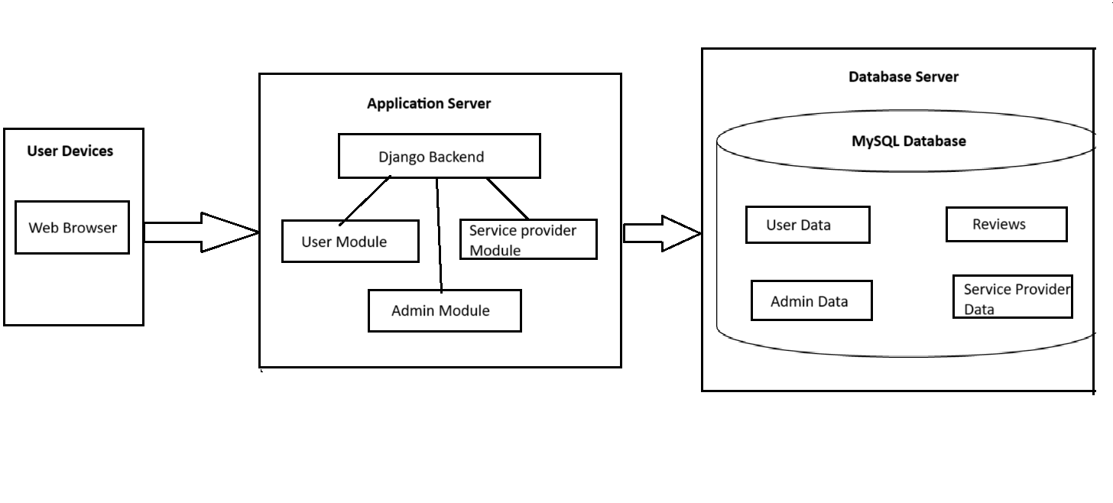
SYSTEM ARCHIETECTURE

Slide 10
MODULES
Browse , Train & Test Datasets : The Admin can upload datasets containing product reviews. These datasets are used to train and test the heterogeneous graph transformer model, which learns to detect patterns of fraudulent reviews by analyzing relationships between users, products, and reviews.
View Trained and Tested Accuracy in Bar Chart : After training the model, the Admin can visually evaluate its performance through bar charts. These charts display accuracy levels, helping the Admin quickly assess how well the model detects fake reviews.
View Trained and Tested Accuracy Results : Apart from charts, the Admin can see detailed numerical accuracy results of the model, including performance metrics such as precision, recall, F1-score, and overall accuracy. This helps in determining the effectiveness of the fraud detection process.

Slide 11
View Detection Product Review Type : Both Admin and User can view the categories of detected product reviews, such as positive, negative, fake, or genuine reviews. This gives insights into how different types of reviews are identified and classified.
Find Detection Product Review Type : The Admin can search and filter specific product review types detected as fake or suspicious to analyze specific cases or trends of fraudulent behavior.
Download Detection Product Review Datasets : The Admin can export datasets that have been processed and labeled by the model, including information on which reviews are fraudulent. This is useful for external analysis or backup purposes.
View Detection Product Review Type Ratio Results : The Admin can see ratio-based insights showing the proportion of different types of reviews (e.g., 70% genuine, 30% fake). This statistical overview helps understand the extent of fraudulent activities within the dataset.
View Profile : Both Admin and User can manage their profile details, such as updating passwords or personal information.

Slide 12
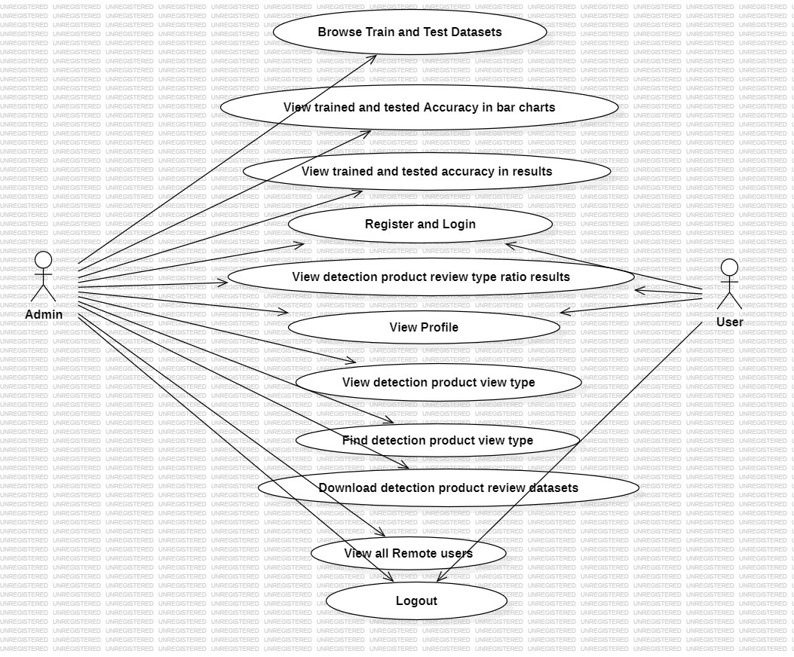
.USE CASE DIAGRAM

Slide 13
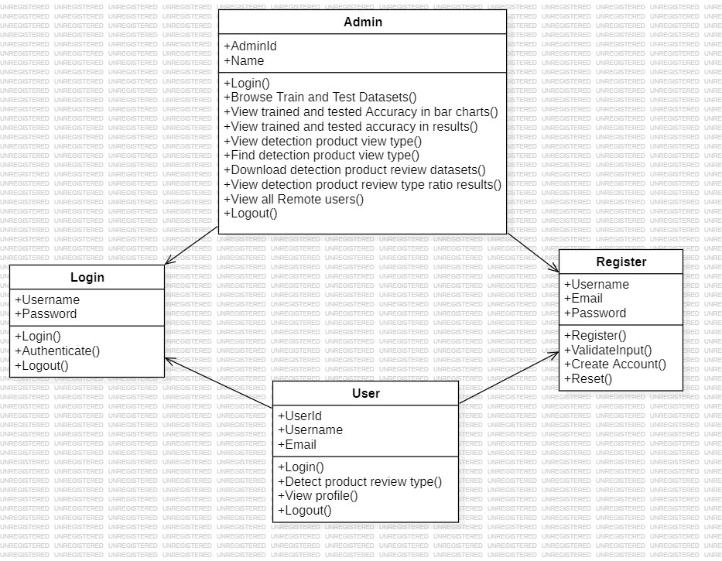
CLASS DIAGRAM

Slide 14
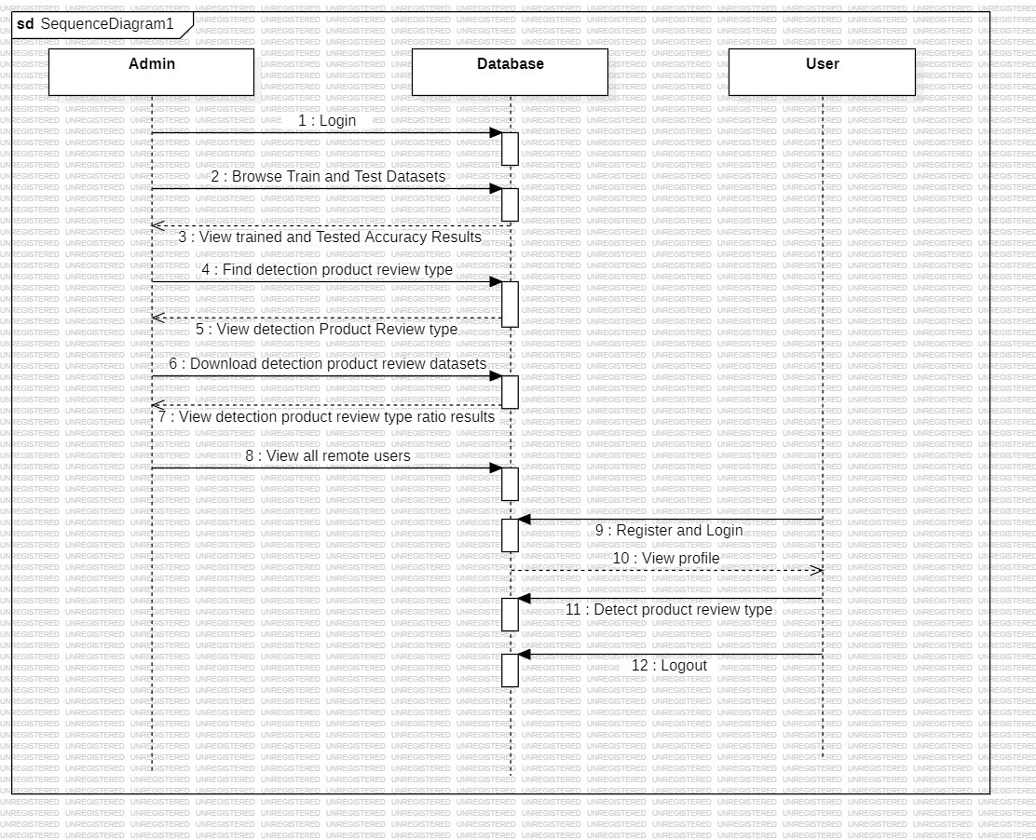
SEQUENCE DIAGRAM

Slide 15
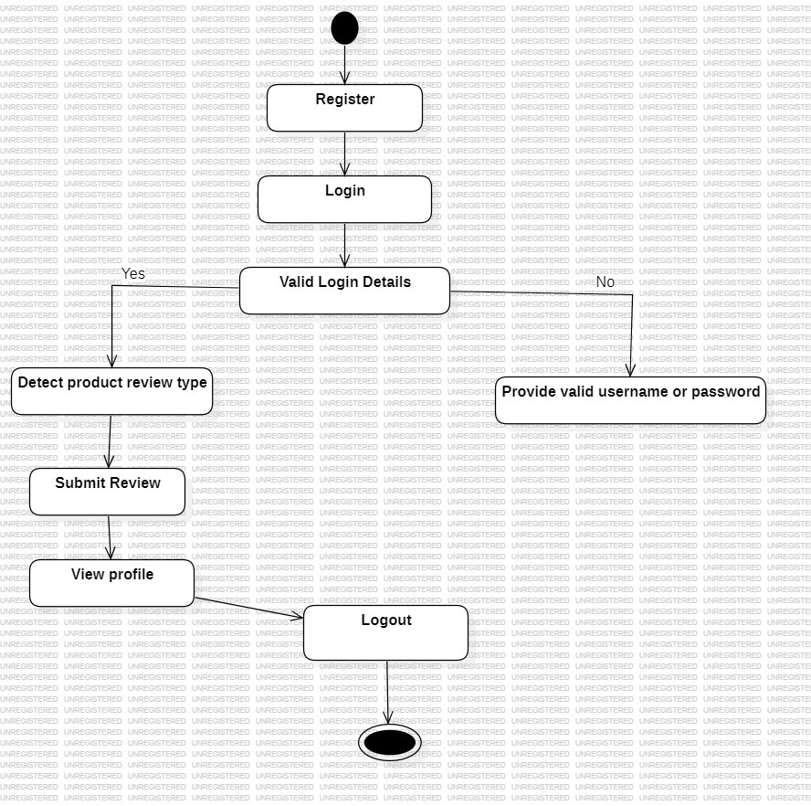
ACTIVITY DIAGRAM(User)

Slide 16
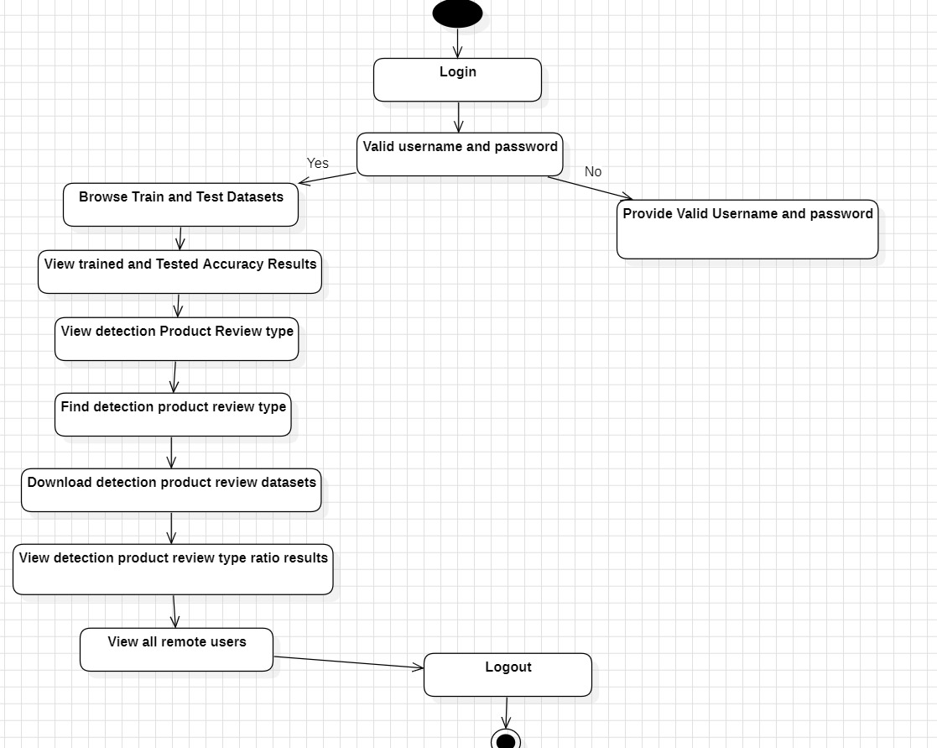
ACTIVITY DIAGRAM(Admin)

Slide 17
SAMPLE CODE
<?xml version="1.0" encoding="UTF-8"?>
<module type="PYTHON_MODULE" version="4">
<component name="NewModuleRootManager">
<content url="file://$MODULE_DIR$">
<excludeFolder url="file://$MODULE_DIR$/venv" />
</content>
<orderEntry type="inheritedJdk" />
<orderEntry type="sourceFolder" forTests="false" />
</component>
<component name="TestRunnerService">
<option name="PROJECT_TEST_RUNNER" value="Unittests" />
</component>
</module>

Slide 18
CREATE TABLE IF NOT EXISTS `auth_permission` ( `id` int(11) NOT NULL AUTO_INCREMENT, `name` varchar(255) NOT NULL, `content_type_id` int(11) NOT NULL, `codename` varchar(100) NOT NULL, PRIMARY KEY (`id`), UNIQUE KEY `auth_permission_content_type_id_codename_01ab375a_uniq` (`content_type_id`,`codename`) ) ENGINE=InnoDB DEFAULT CHARSET=latin1 AUTO_INCREMENT=28 ; INSERT INTO `auth_permission` (`id`, `name`, `content_type_id`, `codename`) VALUES (1, 'Can add log entry', 1, 'add_logentry'), (2, 'Can change log entry', 1, 'change_logentry'), (3, 'Can delete log entry', 1, 'delete_logentry'), (4, 'Can add permission', 2, 'add_permission'), (5, 'Can change permission', 2, 'change_permission'), (6, 'Can delete permission', 2, 'delete_permission'), (7, 'Can add group', 3, 'add_group'), (8, 'Can change group', 3, 'change_group'), (9, 'Can delete group', 3, 'delete_group'), (10, 'Can add user', 4, 'add_user'), (11, 'Can change user', 4, 'change_user'), (12, 'Can delete user', 4, 'delete_user'), (13, 'Can add content type', 5, 'add_contenttype'),

Slide 19
(14, 'Can change content type', 5, 'change_contenttype'), (15, 'Can delete content type', 5, 'delete_contenttype'), (16, 'Can add session', 6, 'add_session'), (17, 'Can change session', 6, 'change_session'), (18, 'Can delete session', 6, 'delete_session'), (19, 'Can add client register_ model', 7, 'add_clientregister_model'), (20, 'Can change client register_ model', 7, 'change_clientregister_model'), (21, 'Can delete client register_ model', 7, 'delete_clientregister_model'), (22, 'Can add client posts_ model', 8, 'add_clientposts_model'), (23, 'Can change client posts_ model', 8, 'change_clientposts_model'), (24, 'Can delete client posts_ model', 8, 'delete_clientposts_model'), (25, 'Can add feedbacks_ model', 9, 'add_feedbacks_model'), (26, 'Can change feedbacks_ model', 9, 'change_feedbacks_model'), (27, 'Can delete feedbacks_ model', 9, 'delete_feedbacks_model

Slide 20
import os import sys def main(): """Run administrative tasks.""" os.environ.setdefault('DJANGO_SETTINGS_MODULE', 'fraud_detection_in_online_product_review.settings') try: from django.core.management import execute_from_command_line except ImportError as exc: raise ImportError( "Couldn't import Django. Are you sure it's installed and " "available on your PYTHONPATH environment variable? Did you " "forget to activate a virtual environment?" ) from exc execute_from_command_line(sys.argv)

Slide 21
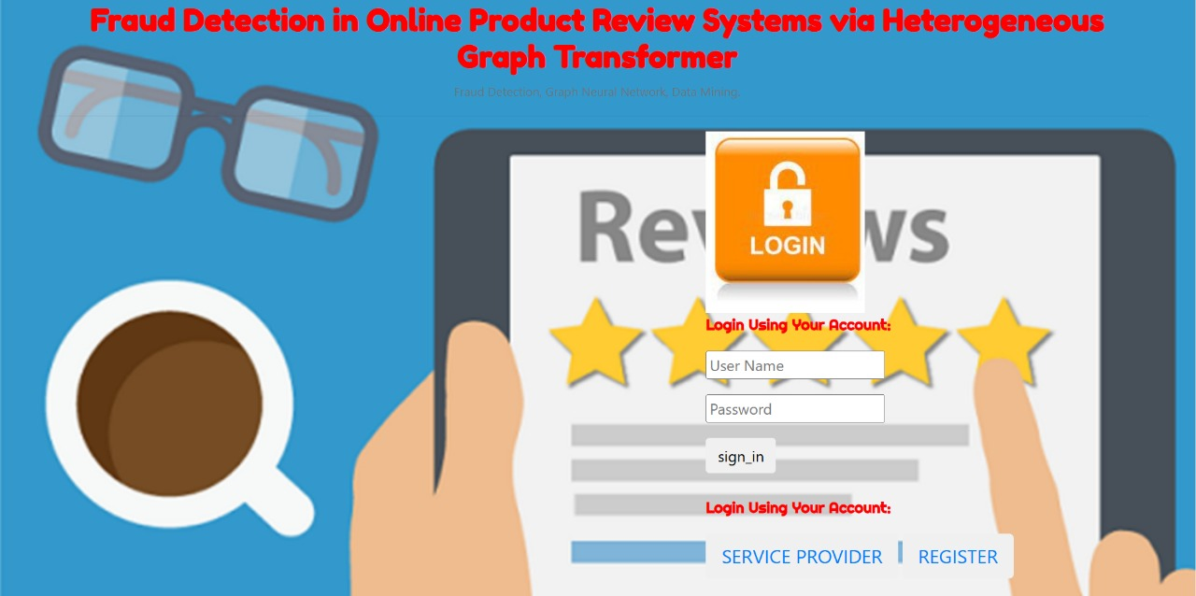
RESULTS

Slide 22


Slide 23
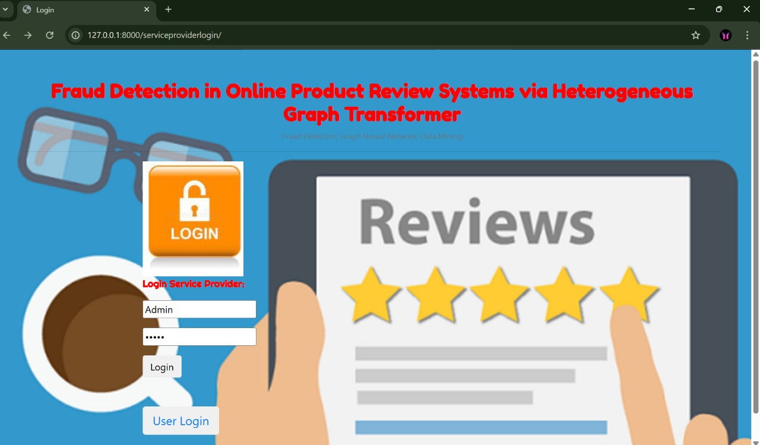

Slide 24
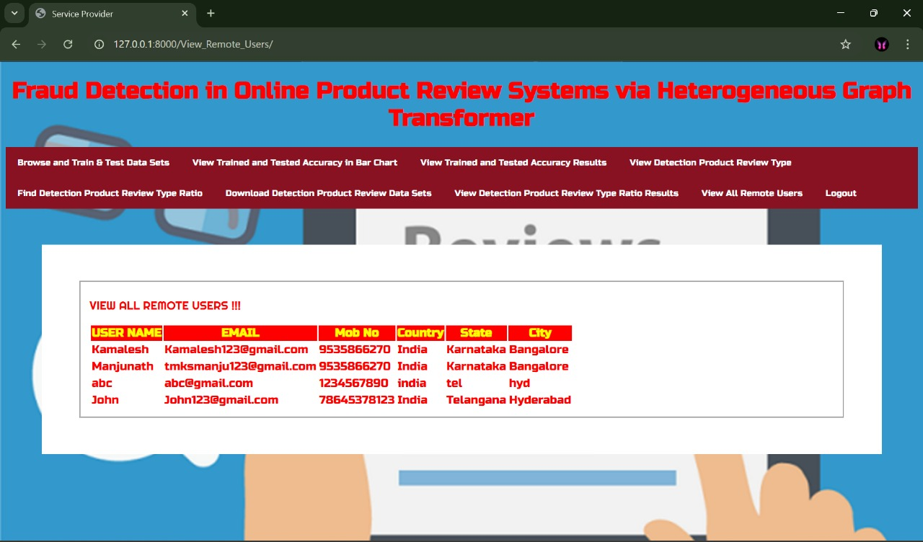

Slide 25
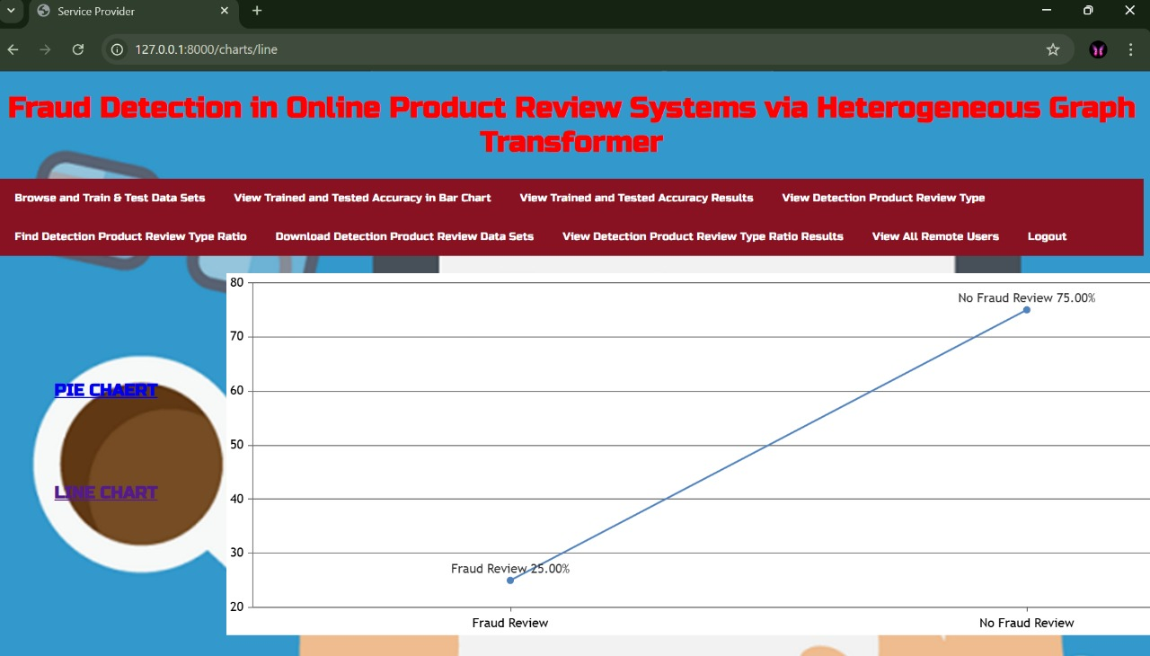

Slide 26
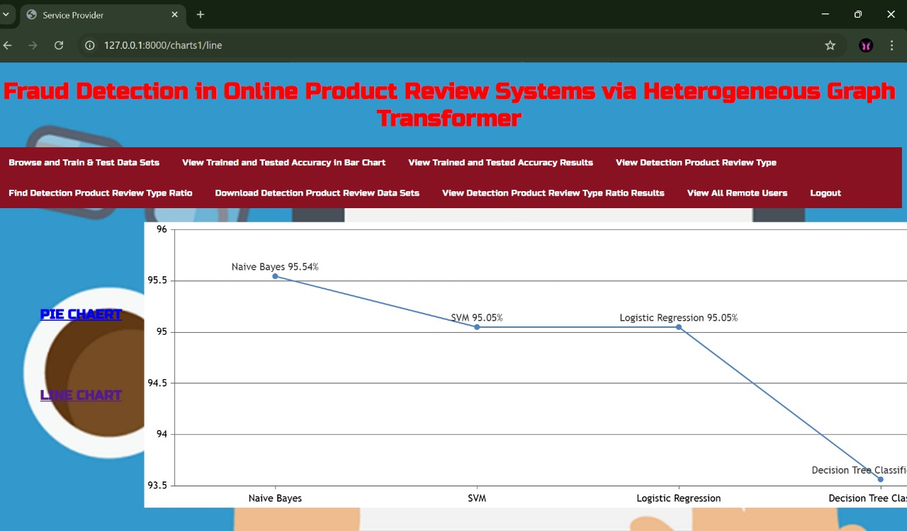

Slide 27
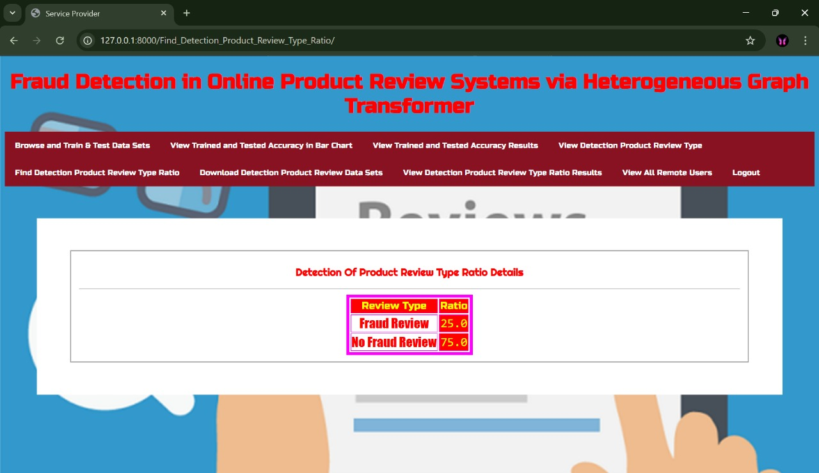

Slide 28
Conclusion :
Fraud detection in online review systems using heterogeneous graph transformers presents an effective solution to combat fraudulent activities. By leveraging the unique capabilities of heterogeneous graphs to represent diverse entities and their relationships, combined with the advanced contextual understanding offered by transformer architecture, our model significantly improves detection accuracy and reduces false positives compared to traditional methods. The results underscore the potential of this approach to enhance the integrity of online reviews, with future work aimed at refining the model for real-time analytics and adapting to evolving fraud tactics, ultimately promoting trust in digital platforms.

Slide 29
FUTURE SCOPE:
The future scope of the Fraud Detection in Online Review Systems via Heterogeneous Graph Transformer project is highly promising, as it can be expanded to handle larger, real-time datasets from multiple e-commerce platforms to detect fake reviews more accurately and efficiently. By integrating advanced graph neural networks with real-time streaming data, the system can adapt to evolving fraudulent behaviors, making it more robust against new types of review manipulation. Additionally, incorporating sentiment analysis, user behavior patterns, and cross-platform data can further enhance detection capabilities. Future improvements may also involve building automated alert systems, improving model interpretability, and deploying the solution as a scalable cloud-based service for industry-wide adoption.

Slide 30
REFERENCES :
Jindal, N., & Liu, B. (2008). Analyzing and Detecting Review Spam. Proceedings of the 2008 International Conference on Web Search and Data Mining (WSDM).
Hu, J., & Liu, L. (2012). Detecting Fake Reviews through User Behavior and Review Content. Proceedings of the 2012 International Conference on Data Mining.
Liu, B., & Seneviratne, O. (2017). Review Spam Detection with Deep Learning Models. Proceedings of the 2017 IEEE International Conference on Big Data..
Zhang, L., & Zhang, X. (2019). Fraudulent Review Detection on E-commerce Platforms Using Graph-based Models. International Journal of Computer Science and Information Security.
Chen, L., & Zhang, Y. (2023). Improving E-commerce Fraud Detection with Heterogeneous Graph Transformers. Proceedings of the 2023 IEEE Conference on Machine Learning and Applications (ICMLA).
Li, X., & Wang, C. (2024). Deep Learning for Fraud Detection in Online Reviews: An Overview and Future Directions. ACM Computing Surveys, 56(1), 1–40.

Slide 31
Github Link:
https://github.com/kavithaa11/FRAUD-DETECTION

Slide 32
THANK YOU

